Slide 1


Chicago C.A.R.E. Program
CREDIT ABUSE RESISTANCE EDUCATION
PAYING FOR EDUCATION

Slide 2
Picture Yourself in 10 years
What do you see yourself doing?
(provide ideas via chat or in person)
What does it take to get there?
(list careers and how to achieve – education, training, money, etc.)
Many individuals who struggle with student debt do so because they did not carefully think through their educational goals or how to pay for them.

Slide 3
Higher Education is an Investment In Yourself
It takes time, money and effort
It can result in:
  Higher future income
  Better career and job opportunities
  Improved knowledge and abilities
  Heathier lifestyle
  Increased civic involvement
  Like any investment, it also has:
    Risks
    Costs
  Consider and weigh it all before you enroll!

Slide 4
Different Types of Institutions and Programs
Public Universities (in state and out of state)
Private Universities and Colleges
Community/Junior Colleges
Vocational and Technical Training Programs
Apprenticeships
Private For-Profit Programs

Slide 5
Education Is Not Cheap
Average Cost in 2022-2023 was:
  Public (2 Year school) tuition, expenses, R&B* $19,230
  Public tuition, expenses, R&B* (in state) $27,940
  Public tuition, expenses, R&B* (out of state) $45,240
  Private tuition, expenses, R&B* $57,570
  *R&B average $9,610 for 2-year school, $12,310 for public 4- year school and $14,030 for private 4- year school.
  Source: College Board, Trends in College Pricing and Student Aid 2022
Notes:
College Board, Trends in College Pricing and Student Aid 2022, Figure CP-1. https://research.collegeboard.org/media/pdf/trends-college-pricing-presentation-2022.pdf.
Updated 2023-08-24 RC.

Slide 6
Other than student loans, how do people pay for post high school education?
  Try to answer this question before
  we go to the next slide
Notes:
CARE volunteer should ask students to guess at sources before going to the next slide.

Slide 7
Sources for financing education
Notes:
2023 How America Pays for College Report by Sallie Mae/Ipsos, https://www.salliemae.com/content/dam/slm/writtencontent/Research/HowAmericaPaysforCollege2023.pdf.
Updated 2023-08-24 RC.

Slide 8
Let’s Start with Grants & Scholarships
Why are Grants & Scholarships so great?
(See if you can answer this question in chat or live)

Slide 9
GRANTS AND SCHOLARSHIPS ARE
FREE MONEY
Average amount of undergraduate grants and scholarships: $13,756
On average, grants and scholarships cover over 1/3 of costs
Available for Trade schools
Notes:
2023 How America Pays for College Report by Sallie Mae/Ipsos, https://www.salliemae.com/content/dam/slm/writtencontent/Research/HowAmericaPaysforCollege2023.pdf
Updated 2023-10-15 RC.

Slide 10


Primary Federal Grants are
Pell Grants
capped at $7,395/student/year (2023-24)
do not need to be paid back
need-based
Notes:
https://studentaid.gov/announcements-events/pell-max-award
Updated 2023-10-15 RC.

Slide 11

Primary Illinois Grants Are
Illinois Monetary Award Program (MAP)
Illinois resident who attends an Illinois approved educational institution
need-based financial aid awarded on a first-come, first-served basis to about 140,000 students a year.
Up to $8,400 a year for tuition and mandatory fees paid directly to school
Notes:
https://www.isac.org/students/during-college/types-of-financial-aid/grants/monetary-award-program/#Description
Updated 2023-10-15 RC.

Slide 12

Scholarships
Money that does not have to be paid back!
Awarded on the basis of merit, skill, need or unique characteristics
Do not pay for help to find scholarships – it’s usually a scam

Slide 13

Places to look for Scholarships
  -- High School Counselor
  Your Community
    Local Businesses, Community Clubs, Workplace or Professional Affiliations
  The educational institution you plan to attend
  On the Internet
    fastweb.com collegeanswer.com
    collegeboard.com Studentscholarshipsearch.com
    gocollege.com Finaid.org
    scholarshiphelp.org careerinfonet.org/scholarshipsearch
    Collegegreenlight.com

Slide 14
Scholarships for Everyone
Create-A-Greeting-Card $10,000 Scholarship Contest
The Asparagus Club Scholarship ($2,000) for those pursuing a degree in business, food management or grocery industry.
The American Fire Sprinkler Association (5 -$1,000). Read a short essay about sprinklers and fire safety and take a 10-question quiz (each correct answer gives you a chance to win).
Vegetarian Resource Group ($5,000) show you promote “a peaceful world through a vegetarian diet/lifestyle”
Beans For Brains Scholarship (5 -$2,500) proficient knitters or crocheters.
Fifth Month Scholarship ($1,500) you must write a letter to the number five (#5) and explain why the number five is so important.
Zombie Apocalypse Scholarship ($2,000) Imagine zombies have taken over your school Write an essay on how will you survive.
Two Ten Foundation Footwear Design Scholarship ($1,000 -$5,000) is available to any student who is studying design with a focus on footwear
American Association of Candy Technologists ($2,500) majoring in food science
Notes:
The point is that scholarship money is available from all sorts of unlikely places if you look for it. Scholarships also available based on ethnicity, gender, religious affiliation, etc.

Slide 15
Student Employment
Get work-study financial aid in school
  Based on need
  on-campus job
  10 – 15 hours per week and paid directly to student
Get a job!
  Learn about your industry and network for future employment
Apprenticeships (www.apprenticeship.gov)
  Paid Job - Mentorships
  Work based leaning - Credentials
  Classroom learning

Slide 16
Student Loans
Student Loans should be your last source for funding.
Why?
(Try to answer in chat or live)

Slide 17

Student loans
Student loans should be your last source of funding.
Because student loans
  are DEBT.
This Photo by Unknown Author is licensed under CC BY-NC-SA

Slide 18


Student loan debt
The average student loan debt owed at graduation from a four-year college is $29,100
Notes:
https://research.collegeboard.org/media/pdf/trends-in-college-pricing-student-aid-2022.pdf
Updated 2023-10-15 RC.

Slide 19
Many Students With Loans Don’t Know:
The interest rate on their loans
Repayment terms
Differences between federal and private loans
The other significant options for financing their education that are NOT loans
Notes:
In one survey:
92% of students did not know their interest rate
94% of students did not know their repayment terms
76% of students did not know the difference between federal and private loans
96% of students did not know that student loan refinancing was an option after graduation
93% did not know the difference between subsidized and unsubsidized loans

Slide 20
Our 3 messages about borrowing for education
Student loans should be your last financing option
  Student loans are debt
  Only use student loans when all other sources are exhausted
Do not borrow more than you can afford
Be smart about the type of student loan you get – Federal vs Private

Slide 21
Let’s Review what we have learned so far by playing Kahoot
www.Kahoot.it – (we will have a game designed for this presentation and this will be the recommended first of two breaks for playing the game.)

Slide 22

Each year, the federal government awards roughly $ 242 billion to students through grants, loans, work-study and other aid.
How do you access this money?

Slide 23

FAFSA
Free Application For Federal Student Aid
(FAFSA.GOV)
Grants and loans for most educational programs require you to fill out a FAFSA
FAFSA forms can be submitted starting October 1 of your senior year in high school
Fill them our early. Money can run out
Fill out FAFSA on-line by first setting up an account. You will need bank account information and tax returns.
You must fill out a FAFSA each year you are in school that you wish to apply for financial aid.

Slide 24
How will you know what financial aid you are awarded?
In the spring of your senior year, you will receive a financial aid letter from each educational institution that accepted you.
The letter will tell you:
  grants you will receive.
  If you will get work-study funding.
  If you applied for a scholarship from the educational institution, it will tell you if you will receive it.
  Federal loans you are eligible to receive.

Slide 25
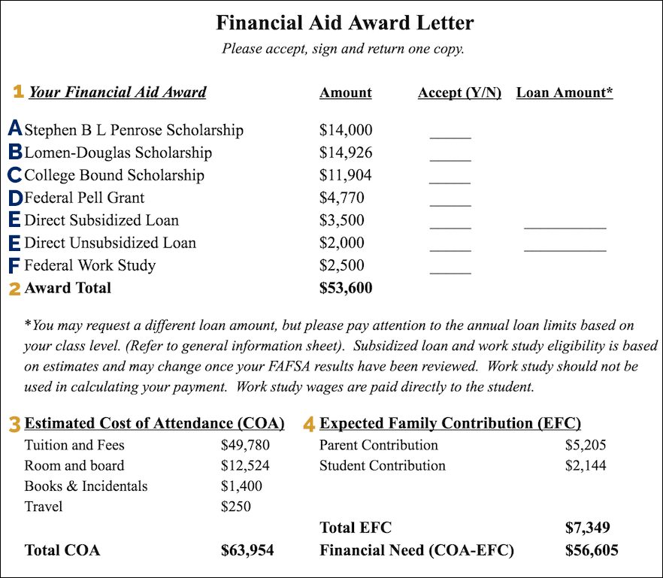

Slide 26
If you don’t understand the letter, call the financial aid office!
Ask questions. For example, will the financial aid award be given every year or do you have to re-apply?
Advocate for yourself. If you need more money, ask for it.
Make sure you understand what is “free money” and what money has to be repaid.

Slide 27


How much student loan debt can you afford?
  Rule of thumb: Your total student loan debt should not exceed your first-year salary after completion of your education
  A search of the internet will show you how much entry level salaries are in any profession in any location.
This Photo by Unknown Author is licensed under CC BY-SA
This Photo by Unknown Author is licensed under CC BY-NC-ND
Notes:
This is a good time to ask students to start filling out the “student loan decision path” handout if you are going to use it with your presentation
It is recommended that you limit your borrowing so that your monthly payment is no more than 8-10 percent of your monthly gross salary (see next slide)

Slide 28
Occupation
Starting Salary/Manageable Student Debt
High School Diploma
  Retail
  Secretary
  Home Health Aid
Associate /Trade School/Apprenticeship
  Administrative Assistant
  Plumber
  Truck Driver
  Electrician
  Medical Technician
Bachelor’s Degree
  Teacher
  Registered Nurse
  Law Enforcement
  Accountant
  Nuclear Engineer
  Software Developer/Engineer
Professional Degree
  Dentist
  Veterinarian
$30,000
$31,600
$24,150
$34,625
$37,015
$38,275
$51,400
$54,675
$45,350
$63,175
$60,200
$60,550
$60,550
$88,850
$100,875
$74,525

Slide 29
Once you have a handle on the amount of student debt you can afford
Ask yourself, will my target school require loans in excess of what I can afford?
  If “yes,” then STOP and re-think about going to this school.
If you can afford to borrow, what kinds of choices do you have in student loans?

Slide 30


2 types of student loans – not all student loan debt is created equal
Federal Private

Slide 31
3 Types of Federal Loans
Stafford Subsidized
Stafford Unsubsidized
PLUS Loans
  (Parent Loans for Undergraduate Students)

Slide 32
Federal Loans are not just for 4 Year Colleges
Federal Student Loans are also available for:
  accredited trade schools
  Courses you need to enter a degree program
  Courses you need to get certified (or recertified) as a teacher
  Certification program that is training you for a specific career
  But, if your program does not end in a degree, you might not have access to federal student loans!

Slide 33

Federal Subsidized Stafford Loans
  Need-Based
  Your school determines the amount you can borrow
  Federal government pays interest while in school and for 6 months after you leave school
  Requires that you start paying the loan back 6 months after graduation

Slide 34
Federal Unsubsidized Stafford Loans
NOT NEED BASED
You owe interest from day one. You may pay the interest while in school or defer it.
If you defer your interest, it will accrue (accumulate) and be capitalized (be added to the principal amount of your loan).
Requires you start paying the loan back 6 months after graduation

Slide 35


PLUS LOANS (highlights)
Need based
Parents can borrow up to cost of attendance minus any other financial aid award amounts
Parents must have excellent credit history
Also available to graduate students

Slide 36

5 key features of federal loans

Slide 37
1. Fixed interest rates
5.50%
5.50%
8.05%
All interest rates are fixed rates for the life of the loan.
Interest rates are reset each year but once you take out a loan the interest rate is fixed for that particular loan.

Slide 38
2. Cap on amounts
Yearly caps
  $5,500 to $12,500
Cap on total amount borrowed
Interest deferral which in school
4. Long cure (grace) period – 270 days

Slide 39
5. Friendly Repayment Options
Fixed payments over 10 year period. That is 120 monthly payments.
Other options:
  Extended Plan - extends repayment period with lower monthly payments
  Pay as you earn – pay only 10% of your income
  Graduated Plan – payments are lower at first and then increase usually every 2 years

Slide 40
Loan Forgiveness Programs
Teacher Loan Forgiveness:
Teaching full-time in a low-income elementary or secondary school for five consecutive years
Public Service Forgiveness
  employed full-time (30+ hours/week) in a public service job, such as police, fire, military and charities
  forgives the remaining balance on your direct loans after you have made 120 on-time monthly payments

Slide 41



What is a private loan?
Arranged privately with your bank or other financial institution
Approximately 2.9 million students currently have private loans
Total Private loans outstanding is $146.9 billion (approximately 8.3% of total student debt).
Notes:
https://www.nerdwallet.com/article/loans/student-loans/student-loan-debt#total-private-student-loan-debt

Slide 42

Private loan features
Responsible adult co-signs
Floating interest rates
  depends on credit history
  can go as high as 25%-30%
Immediate payment (not deferred)
No right to postpone or extend payments
Hair trigger defaults

Slide 43
Here’s the bottom line on private student loans
Get them only after you have exhausted all other options for financing

Slide 44
Defaults
Yes, it can happen to you
It was estimated before the Covid-19 pandemic that a quarter of student loan borrowers were either delinquent or in default on more than $175 billion in federal student debt*
Approximately 10.8% of borrowers were in default on federal student loans within 2 years of having to make payments
* Based on U.S. Department of Education, Federal Student Loan Portfolio: Direct Loan and Federal Family Education Loan Portfolio by Loan Status (2019)

Slide 45
WHAT HAPPENS IF YOU DEFAULT?
(for both Federal and Private loans)
Student loans must be repaid whether or not the student finishes his/her program of study
Lender can sue you
Lender can garnish (take a percentage of) wages and (once received) social security benefits
Income tax refunds may be intercepted
Can’t renew professional licenses
It’s on your credit report, with disastrous effects for getting credit cards, auto loans, rental apartment, even a job

Slide 46
I Can Always File Bankruptcy To Get Out Of My Student Loan - Can’t I?
No – it is very difficult to discharge student loans in bankruptcy.
Only one percent of student loan debt gets discharged.

Slide 47
Let’s review what we learned about loans with more Kahoot
www.kahoot.it – (finish the game you started after slide 21)

Slide 48
Summarize
Look for education funding from sources other than student loans
  Fill out FAFSA early
  Apply for grants and scholarships early and widely
  Talk to financial aid officers
Figure out how much in student loans you can afford
  Does your desired career provide the earning power to pay off your loans?

Slide 49
Summarize
3. If you need loans, get federal loans first, private loans last
4. Borrow only what you need
5. DO NOT miss a payment. Default is very expensive

