Slide 1
Paying for Education
Credit Abuse Resistance Education (CARE) Presentation

Slide 2
Picture Yourself in 10 Years
Many who struggle with student debt, do so because they did not carefully think through their educational goals or how to pay for them.
What do you see yourself doing?
Career? Work life? Life outside of work?
What does it take to get there?
Education? Experiences? Relationships?
What risks do you want to avoid?
Bad Planning. Too much Debt.

Slide 3
Education After High School is an Investment In Yourself
It takes time, money and effort
It can result in:
Higher future income
Better career and job opportunities
Improved knowledge and abilities
Healthier lifestyle
Increased civic involvement
Like any investment, it also has:
Risks
Costs
Consider and weigh it all before you enroll!

Slide 4
Education Is Not Cheap
Average Total* Cost in 2022-2023 was:
Community/Jr. college $19,230
Public in state college $27,940
Public out of state college $45,240
Private college $57,570
* Tuition, Room & Board, Expenses
Notes:
College Board, Trends in College Pricing and Student Aid 2022, Figure CP-1. https://research.collegeboard.org/media/pdf/trends-college-pricing-presentation-2022.pdf

Slide 5
Pick the School that makes the most sense for you
What you can afford and what your degree will be worth
Average:
Grants and Scholarships per student a year: $11,550
Student Loan Amount at graduation: $29,100
Monthly payment: $303
Notes:
Sources: (1)College Board, Trends in College Pricing and Student Aid 2022, Figure SA-1. https://research.collegeboard.org/media/pdf/trends-in-student-aid-presentation-2022.pdf; (2) https://research.collegeboard.org/trends/student-aid/highlights

Slide 6
?
Other than student loans, how do people pay for post high school education?
Try to answer this question before we go to the next slide
Try to answer this question before we go to the next slide

Slide 7
Sources for financing education
You don’t need money from all of these categories.
Every person will have a unique mixture.
Notes:
2023 How America Pays for College Report by Sallie Mae/Ipsos, https://www.salliemae.com/content/dam/slm/writtencontent/Research/HowAmericaPaysforCollege2023.pdf.

Slide 8
Grants and Scholarships are
Federal Pell Grants $7,395 year
Scholarships can be found everywhere!
Talk to your high school counselor
Local businesses, community clubs, religious organizations, civic groups, workplace or professional affiliations
The school you plan to attend
On the Internet – Get aggressive and creative:
fastweb.com | collegeanswer.com | collegeboard.com | studentscholarshipsearch.com | gocollege.com finaid.org | scholarshiphelp.org | careerinfonet.org/scholarshipsearch | collegegreenlight.com
Notes:
https://studentaid.gov/understand-aid/types/grants/pell

Slide 9
Student Employment
Get work-study financial aid
On-campus job, including in academic departments
Can be terrific way to build experience in your field
Based on need
10 – 15 hours per week, paid directly to student
Get a job from a private employer
Learn about your industry and network for future employment
Get a paid apprenticeship
www.apprenticeship.gov
Work-based learning
Find mentors
Build credentials

Slide 10
Our 3 messages about borrowing for education
Student loans should be your last financing option
Student loans are debt
Only use student loans when all other sources are exhausted
Do not borrow more than you can afford*
Be smart about the type of student loan you get – Federal vs Private
* No more than your expected first year’s salary

Slide 11
FAFSA Free Application For Federal Student Aid
FAFSA.gov
Grants and loans for most educational programs require you to fill out a FAFSA
FAFSA forms can be submitted starting in the fall of your senior year
Fill them out early. Money can run out
Fill out FAFSA online by setting up an account. You will need bank account information and tax returns.
You must fill out a FAFSA each year you are in school that you wish to apply for financial aid.

Slide 12
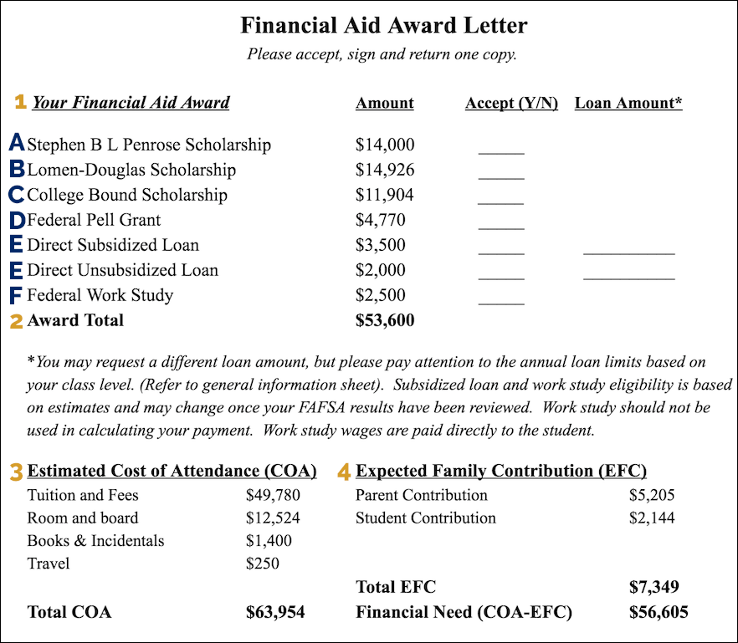

Slide 13
If You Don’t Understand the Letter, Ask Questions!
Call the school’s Financial Aid Office.
Ask questions. For example, will the financial aid award be given every year or do you have to re-apply?
Advocate for yourself. If you need more money, ask for it. They want you to attend.
Make sure you understand what is “free money” and what money has to be repaid.

Slide 14
Federal Loans are not just for 4 Year Colleges
Federal Student Loans are also available for:
Junior and community colleges
Accredited trade schools
Courses you need to enter a degree program
Courses you need to get certified (or recertified) as a teacher
Certification program that is training you for a specific career
But, if your program does not end in a degree, you might not have access to federal student loans!

Slide 15
Five Key Features of Federal Loan
1
2
3
4
5
Fixed interest rates
Caps on amounts
No interest paid while in school
Long cure (grace) periods (270 days)
Friendly repayment options (10 years)
Plus: Loan Forgiveness Programs

Slide 16
Private Loan Features
Responsible adult co-signs
Floating interest rates
depends on credit history
can go as high as 25%-30%
Immediate payment (no right to deferral)
No right to postpone or extend payments
Hair trigger defaults

Slide 17
What happens if you DEFAULT? (for both federal and private loans)
Student loans must be repaid, whether or not you finish the program of study
Lender can sue you for payment
Lender can garnish (take a percentage of) wages and (once eligible) social security benefits
Lender can intercept income tax refunds
You can be prevented from renewing professional licenses
Default goes on your credit report, with disastrous effects for getting credit cards, auto loans, rental apartments and even some jobs
Student loans may not be discharged in Bankruptcy

Slide 18
Summarize
Pick a school you can afford, considering what you will earn once you graduate
Look for educational funding from sources other than student loans
Fill out FAFSA early
Apply for grants and scholarships early and widely
If you need loans, get federal first, private last
Borrow only what you need
DO NOT miss a payment

