Slide 1
Get Smart About Identity Fraud
Credit Abuse Resistance Education (CARE) Presentation

Slide 2
Identity Theft Can Destroy Your Credit
In this program we will first talk about Credit Scores and Credit Reports.
If your identity is stolen, your Credit Report and Score can be negatively affected if new accounts are opened under your name and left unpaid.

Slide 3
What is a Credit Report?
It is an adult report card of how you manage your finances.
Credit Reports are established using information provided by banks, stores, utilities, and collection agencies. The information is stored and given to Credit Reporting Agencies (Agencies).
Agencies get payment information from other businesses that deal with the public, such as banks, cell phone companies, stores and utilities.
The information on a Credit Report is used to calculate a Credit Score. If you have a high credit score, it will be easier and cheaper for you to borrow money.

Slide 4
What is Used to Calculate a Credit Score?
Your credit score can be based on:
Your payment history for all your accounts;
How much you owe on credit;
How long you have had credit with a particular company, like a credit card;
How much of your available credit you actually use; and
How frequently you apply for credit and the number of newly opened accounts.
New Credit
10%
Types of Credit Used
10%
Payment History
35%
Credit History Length
15%
Amount Owed
30%

Slide 5
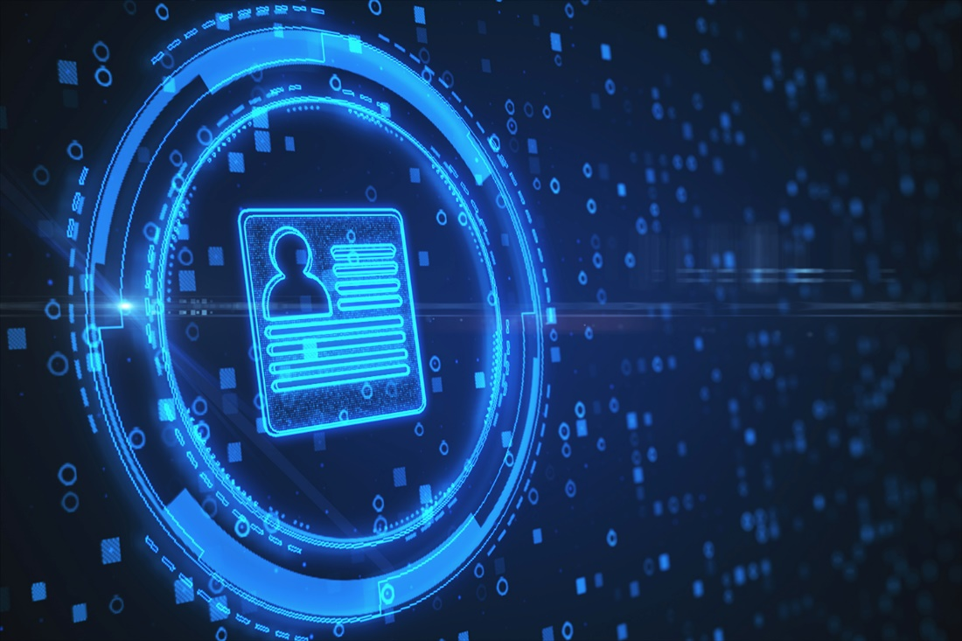
What is Your “Identity”?
“Private Data” or PII (Personal Identifiable Information) that identifies you uniquely, which means some or all your:
Personal Information - Social Security Number (SSN), name, address, date of birth, mother’s maiden name, etc.
Account Numbers - credit cards, bank accounts
Passwords & PINs - email, online banking

Slide 6
What is Identity Theft?
Someone’s use of your identity (Private Data) to buy goods or services, such as by:
Applying for credit in your name.
Taking over existing accounts you have.
Intercepting government payments such as income tax refunds, stimulus checks, or unemployment checks.

Slide 7
How Does Identity Theft Happen?
A friend, relative, or roommate finds your Private Data.
A bill or statement is left in the open
A professional thief digitally intercepts your Private Data as you are making a purchase, such as when you buy gas with a credit card.
You are the victim of a major hack or security breach that can affect millions of people.
You provide Private Data to a fraudulent person without knowing it.

Slide 8
Some Tips to Avoid Being a Victim
When leaving your home, take only debit cards and credit cards that you actually use
Do not put your Social Security card in your wallet
Do not share Personal Data, account numbers or passwords with anyone unless it is someone who has a legitimate business reason for having them
Keep passwords hidden (use an online vault)
Notes:
Demand Deposit Accounts (checking / saving) are not reported to the CRC’s; therefore, not included in traditional credit scores

Slide 9
Financial Abuse
The Goal
To gain power and control in a relationship.
Does it really happen?
Yes–99% of domestic violence situations
The Warning Signs
Controlling spending
Ruining credit
Interfering with finances
Limiting or forbidding work
Getting Help
Protect personal info
Regularly check your credit report
Prepare for the future
Find support

Slide 10
What Does it Mean to Get Hacked?
When someone get access to your device (phone, iPad, laptop) and has taken your Private Data from it.
When someone gets access to or tampers with information in your computer, such as cookies and browser histories, to steal your Private Data.

Slide 11
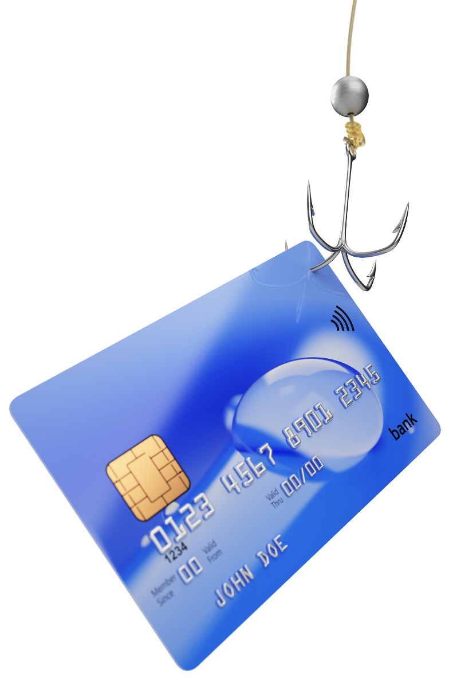
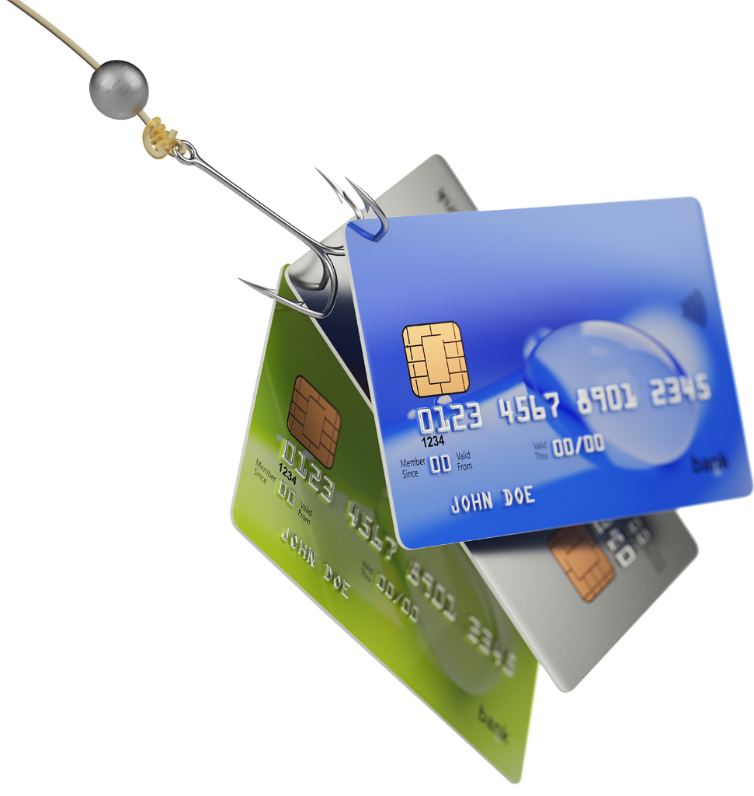
Another Way You Get Hacked is
Phishing
Pharming
or

Slide 12
What are Phishing and Pharming?
An email, text or call, that looks like it is coming from someone you know or from a company you have an account with, seeking to get your Private Data.
The email address is faked to make it appear as if it is coming from a sender you know such as Paypal, Venmo, your bank, etc.
Phishing – You will be asked to provide Private Data by email or text
Pharming – You will be re-directed to a fake web site that will ask you to input your private data

Slide 13
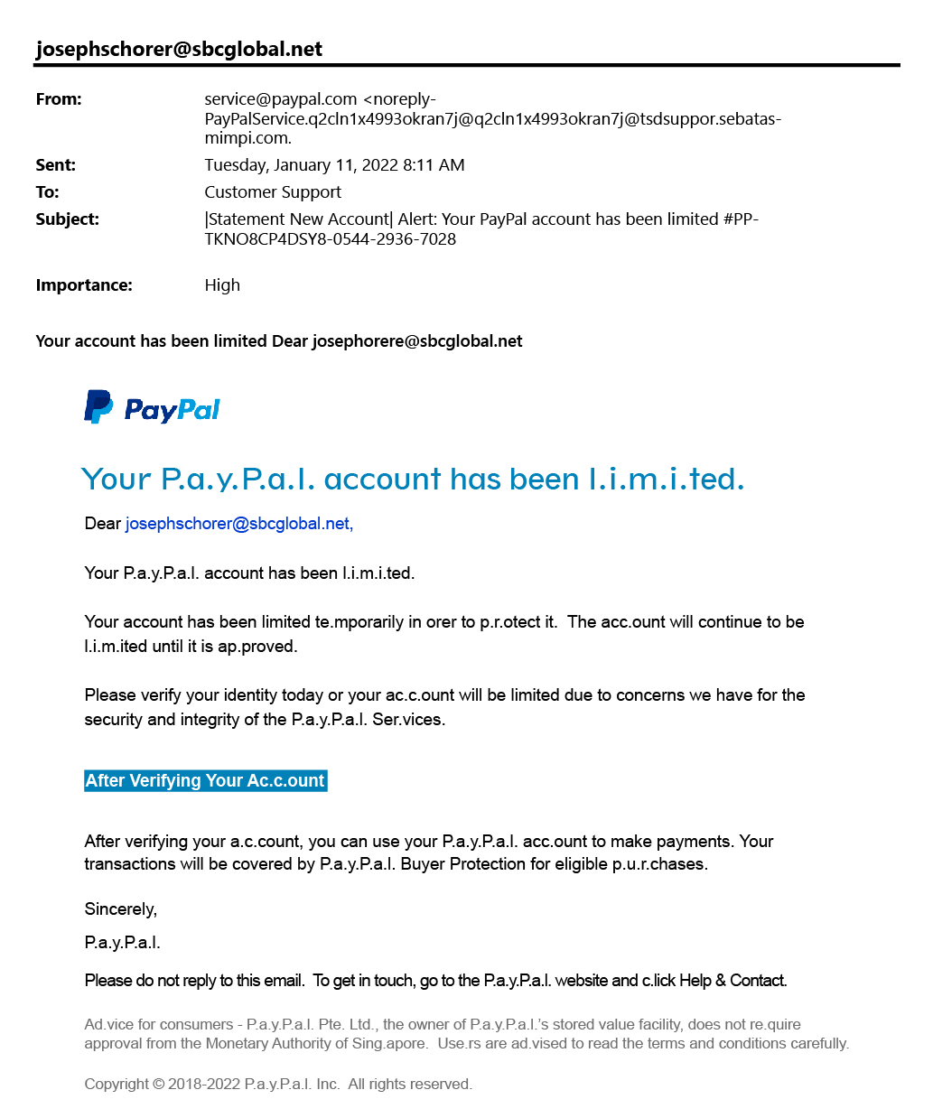
What is sebatasmimpi.com?
Weird Language
Lots of Grammatical and
Punctuation Mistakes
Pharming Trap

Slide 14
How Do You Protect Yourself Against Phishing and Pharming?
First, never respond to an email or phone request asking for your private data.
Honest businesses and companies will never ask you to email or text them your Private Data.
If you get a call from someone asking for your Private Data, hang up, or call the company back on a phone # YOU know is correct. DO NOT ASK THE PERSON WHO CALLED YOU TO GIVE YOU A NUMBER TO CALL BACK ON.

Slide 15
How Do You Protect Yourself Against Phishing and Pharming?
Second, if an email asks you to click on a link that it says will take you to a secure site to enter your private data,
GOOD
Check the link by hovering your mouse over it
BETTER
Go directly to the company’s web site
BEST
Ignore the message

Slide 16
What is Multi-Victim Fraud?
That’s where the fraudster hacks a computer database to steal private data of many people stored there
Your Bank
Your Employer
A Store You Shop At
e.g., JP Morgan
e.g., City of Chicago
e.g., Target

Slide 17
What is the Dark Web?
Surface Web
The dark web is found on the Internet but requires specific software, configurations, or authorization to access.
These websites are hidden from traditional search engines and require a specific browser.
The dark web is used by criminals to sell to other criminals Private Data stolen from people like you!
Deep Web
Dark Web

Slide 18
Here Are Signs That Someone May Have Stolen Your Private Data
1. Mystery Charges on your bank or credit card statement, e.g., You are charged for a purchase in a city where you do not live
2. Weird messages, e.g., A store you never heard of sends a thank you note for your business
3. Missing mail Someone may have stolen your bank statements to get your account information
4. Collection notices or calls arrive Collection notices show up, or you get phone calls, demanding payment for something you never bought

Slide 19
How do You Protect Yourself Against the Risk That Your Private Data Has Been Hacked?
Keep Important Records in a Safe Place
Available when needed and not easily taken
Check Your Bank and Credit Card Statement for Unknown Charges
Use strong passwords for all accounts and change them periodically
Check your Credit Reports once a year to ensure accounts and balances are accurate Annual Credit Report.com - Home Page
Avoid Credit “Repair” Scams
Often these are operated by identity theft rings
Not to be trusted with your personal information
Corrections to a credit report can be accomplished at no charge by an Agency
Credit Repair companies charge fees and cannot guarantee results
carechicago.org

Slide 20
Act Fast if You Discover A Problem
Close accounts that have been hacked
Change user code and/or password for email accounts other accounts
Contact the credit reporting companies to report fraudulent activity
A fraud alert will be placed on your credit report Any company reviewing your report will be aware of the potential fraud
A security freeze can be placed on your credit report Access to your credit report is restricted
Fraudulent information may be removed from your credit report Upon investigation and confirmation with creditors and police

