Slide 1

Why You Don’t Want to
Go into Bankruptcy
Credit Abuse Resistance Education (CARE) Presentation

Slide 2
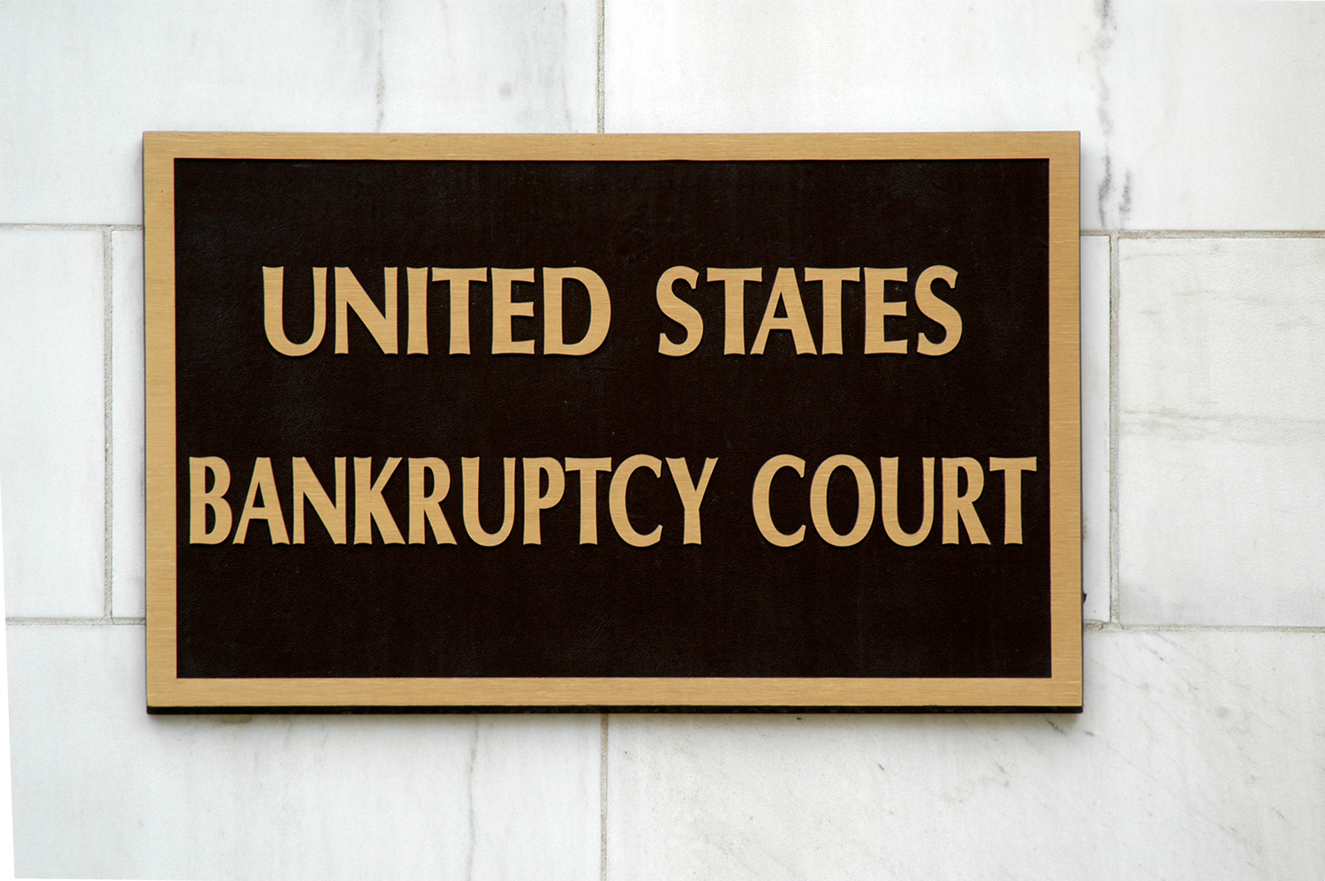
What is Bankruptcy?
Bankruptcy is a court case that is started when a person files a petition for bankruptcy. There is a special court, called the Bankruptcy Court, for these cases.

Slide 3

Why Would a Person File for Bankruptcy?
People file for bankruptcy when they have debts
money they owe to banks and other companies
that they cannot repay.
People are often forced into bankruptcy by bill collectors who try to reach them at home at all hours.
When a person files for bankruptcy, all bill collectors must stop collection efforts.

Slide 4

Two Main Types of
Consumer Bankruptcy
CHAPTER 7 & CHAPTER 13
Things that Chapter 7 and Chapter 13 have in common:
It is a public court process. You have to appear before a judge and report to a bankruptcy trustee.
It is complicated and costly. You must pay filing fees and you really should hire a lawyer.
You have to go through approved credit counseling before filing.
It’s a derogatory mark on your credit report for generally 10 years.

Slide 5

Key Features of Chapter 7
You turn over all your assets except “exempt assets” to a bankruptcy trustee.
Bankruptcy trustee sells all your assets to pay creditors.
You get a fresh start by “discharging” (legally being excused from paying) old debts, but . . .
There are some debts you cannot avoid.

Slide 6

Key Features of Chapter 13
This is for people with “regular income”.
You retain control of your assets.
You must repay a certain percentage of your debts over 3 to 5 years.
You must use all your income, other than that needed for necessary living expenses, to repay your debt.

Slide 7
What are the “Exemptions”?
Creditors and the trustee cannot take away your exempt assets.
Not many things are exempt:
Home equity: $15,000
1 motor vehicle: $2400
Insurance and retirement payments
Professional books and tools of the trade: $1500
Personal and family items (books, souvenirs)
Catch-all: $4,000
That is about it!

Slide 8

There is No Privacy in Bankruptcy
You will have to reveal vast amounts of detailed, intimate, sometimes embarrassing information.
It is a federal crime to lie about your assets. People go to prison for doing that.
All of your information will be on the web, anyone can find it.
People you owe money to, can ask you questions in a public meeting.

Slide 9

You Cannot Avoid Some Debts
For example:
Student loans (see next slide)
Money you owe for buying luxury goods shortly before you file for bankruptcy
Money you borrowed shortly before you file for bankruptcy
Money you owe because you cheated or intentionally hurt someone

Slide 10

Student Loans
Can’t get out of unless “UNDUE HARDSHIP”.
Undue hardship is the inability to repay the loans and maintain a minimal standard of living.
Only one percent of student loan debt is discharged through bankruptcy.

Slide 11

And there is More Bad News . . .
A company can refuse to hire you simply because you filed for bankruptcy!
The bankruptcy trustee can sue your family and friends or a charity to whom you have given a gift.

Slide 12

Conclusion
Bankruptcy
Takes away your privacy
Touches your family, friends, and job
Doesn’t protect you from all your creditors
Is expensive – financially and emotionally
Destroys your credit

