Slide 1

Get Smart About Credit

Slide 2

Why CARE?
Credit is debt – money that must be paid back. Too much debt could ruin your life.

Slide 3


What is credit?
Credit is the ability to borrow money. It costs money to borrow money.
Borrowing money creates debt.
Debt is what you owe.

Slide 4
What does it take to get credit?
The Three “C”s of Credit
Capability: Ability to take on more debt OR expenses compared to income.
Collateral: things that you own that can support payment of a loan.
Character:
History of repaying debt

Slide 5
Let’s talk about some credit topics
Want to learn about credit and debit cards? Click here
Want to learn about about credit reports and credit scores? Click here

Slide 6
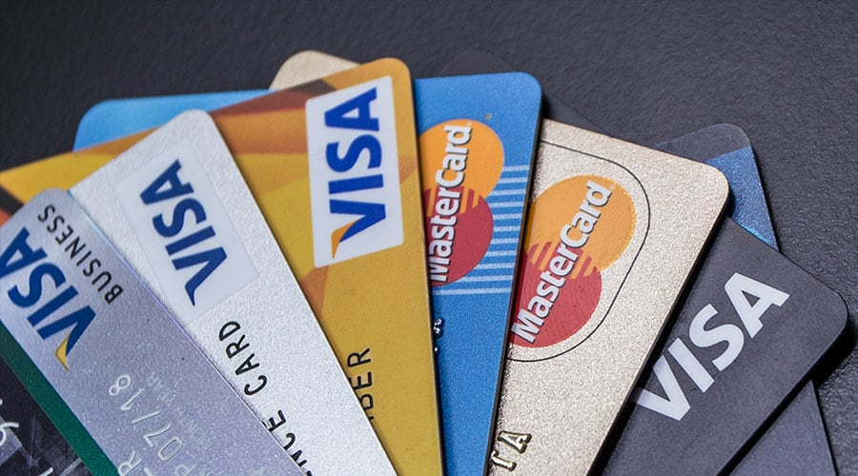
Some Good Reasons to have Credit Cards
Emergencies
Large Purchases
Internet Purchases
Establish Credit History
Safety

Slide 7


Some Downsides to Credit Cards
  It can be expensive to use credit.
  You end up spending more than you think.
  A credit card can:
    be too easy to use,
    lead to unnecessary and even foolish purchases, and
    result in debt you cannot pay.

Slide 8

Why should you care?
You will begin to get credit card offers when you turn 18.
Understanding how credit works and what to avoid when using credit cards is essential before the damage is done.

Slide 9
Debit cards vs. credit cards
A debit card is just like a check.
The money for the purchase comes directly from money in your bank account.
You must have money in your bank account to use the card.
Using a debit card will not help your credit score.

Slide 10
What is Interest?
Remember!
The higher the interest rate, the more money you pay. Also, the longer it takes to pay off a loan, the more interest you pay
Interest - what a lender charges to borrow money (a lender is a person or company that makes a loan)
Card companies charge compound interest (interest on interest).

Slide 11
EXAMPLE
Here is an example that shows that compound interest piles up FAST:
What if you bought…

Slide 12

A Brand New Laptop That Costs $1000

Slide 13
NOW THE BREAKDOWN
you used your credit card (because you did not have enough cash in your bank account)
you make monthly payments of $150
you never miss a payment
annual percentage rate (called the APR) on your card is 15%

Slide 14

What will the laptop really cost you?
(remember, it costs to borrow money)
How long will it take to pay for it?

Slide 15

NOT BAD
Your total cost will be $1051
It will take you SEVEN MONTHS to pay for it

Slide 16
NOW
Instead of a 15% rate, let‘s say that, because your credit rating is only fair, you must pay interest at a rate of 25%.
Also assume that you pay the MINIMUM MONTHLY PAYMENT of only $25 per month.
How long will it take to pay? and how much will it cost?

Slide 17

THAT’S A LONG TIME
It will take you 87 MONTHS
(over 7 YEARS)
to pay for it
Total payment: $2,175!

Slide 18
Minimum Payments Won’t Pay Off Your Credit Card Debt!
What is a “Minimum Payment”?
A credit card bills show a “minimum payment” amount which is usually less than the charges on the card.
Why would the bank not require you to pay all charges in full each month?

Slide 19

The Funny Thing About Credit Cards

Slide 20

Our Point is…
Pay your balance in full and on time every month – this is the single most important point of this presentation.

Slide 21
Credit Card Costs and Fees
Avoid paying unnecessary credit card fees:
Annual fees (about $65 a year);
Late fees and charges (up to $35 each time);
Fees for going over credit limit; and
Cash advance fees.
(These fees are in addition to interest.)

Slide 22
How do you find the best card?
Credit cards are like pizzas – they aren’t all the same.
Ask around, or shop around, for a card with a low interest rate and low fees

Slide 23
Want to talk about some other credit topics?
Click here to learn about about credit reports and credit scores
Or click here to test yourself on some wind-up questions

Slide 24

Other Types of Credit
Long Term Credit – payments made over several months or years
  Mortgages to buy a house or condo
  Car Loans
  Student Loans
②Short Term Credit – single payments
  Charge cards
  Utility Bills
  Cable/Satellite
  Cellular phone bills and data plans

Slide 25


Types of Credit
Other credit commonly used
  Payday loans
  Pawn shops
  These types of credit can be available in an emergency, and when no other credit is available. But they are very expensive.

Slide 26
Point-of-sale Installment Loans
What are they? Are they Credit Cards?
Companies give you the option to obtain credit next to the purchase price in your online shopping cart, or at the checkout counter in-store.
Example

Slide 27
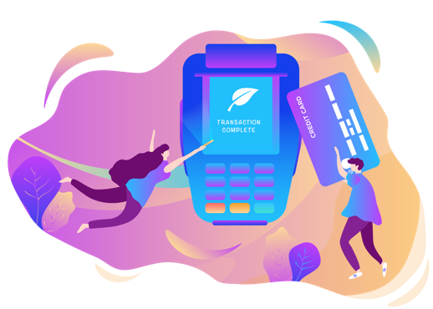

How to Apply for Point-of-sale credit?
You enter your personal information — name, date of birth and last four digits of your Social Security number, or just your phone number.
If you’re approved, you sign the agreement and finish checking out. Just like using a store credit card.

Slide 28

PROS of Point-of-Sale Installment Loans
Can borrow a small amount
Convenient for big, one-time purchases
Can use loan within minutes of applying and being approved
Potentially low Interest rate (depending on borrower’s credit)
Few, if any, fees
Multiple loans allowed without harming your credit score
Simple loan terms

Slide 29

Cons of Point-of-Sale Installment Loans
Some charge very high interest rates (as high as 30%)
Short Loan terms (3 to 12 months)
Repayment schedules too fast for borrowers’ budgets
Potential late fees
Lack of choice with loan providers at checkout
Lenders may not report to credit bureaus
Can lead to over-spending

Slide 30

Pawn Shops
Loan money in exchange for something valuable you own that the shop can keep or resell if you do not repay the loan, interest and all fees.
Loan will be a fraction of the value of the item.
Pawn shops can charge high fees. You should understand everything you have to pay back before taking out a loan!

Slide 31
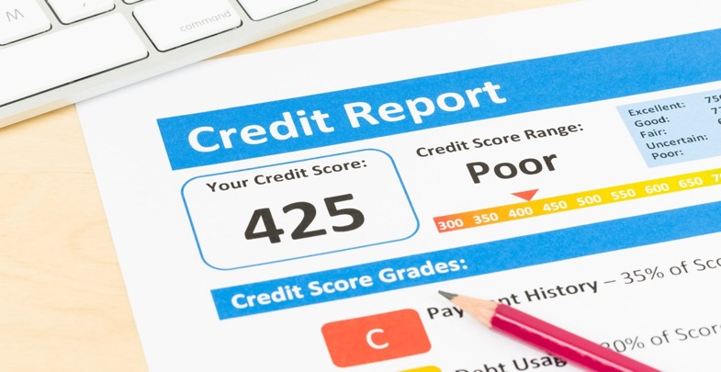
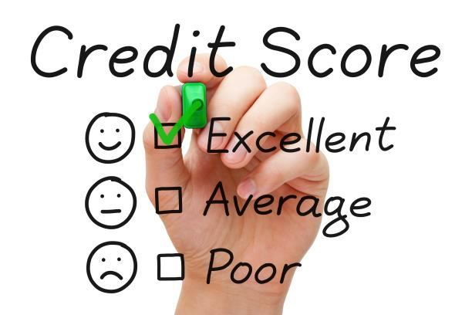
Credit Reports and Credit Scores Are Key Tests by Which You Will Be Graded in the Adult World

Slide 32
What is a Credit Report?
Think of it as your adult report card.
It’s a report of a person’s financial reliability.
Credit reporting companies prepare it for other companies that make credit or loans available to the public.

Slide 33
Credit Reporting Companies
Three primary credit bureaus in the US: Equifax, Experian and TransUnion
Companies, like phone companies, collect and sell credit information on individual people.

Slide 34
How Credit Reporting Works
You apply for credit - often the application is made to a store or provider of a service, like electricity.
The person you want credit from (store or service provider) gets a credit report about your financial history
Credit report used to determine whether to give you credit—and if so, at what interest rates

Slide 35
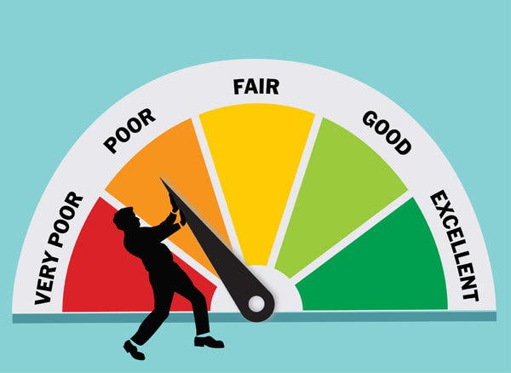
What is a Credit Score?
Your credit score is your adult GPA
A number credit scoring companies calculate and lenders use to see how likely you are to repay loans
If credit is denied after reviewing the score, credit card company or lender must give you the reason for the decision

Slide 36
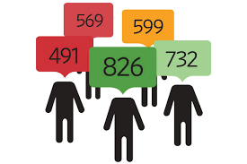
What items are used to calculate a credit score?
Credit score is calculated based on:
Payment history;
Types of credit used;
New credit;
Credit history length; and
Amounts owed.

Slide 37

What information is NOT used
to calculate a credit score?
Demographic information --age, race, religion, national origin, gender, sexual orientation, marital status, child/family support obligations
Employment information
--salary, occupation, employer, employment history
Payments made with cash or debit cards

Slide 38

Factors That Hurt Your Credit
History of late/past due/missed payments
Short credit history
Having too much credit
Having no credit
Having too many inquiries
Judgments against you/bankruptcy

Slide 39
People can learn a lot about you from about your Credit Reports and Credit Scores
Creditors, landlords, employers might all look at your credit report or score.
Any potential creditor can get your report by paying a small fee.
How about people you date? People with similar scores stay together more than people with scores that are very different.

Slide 40
Check Your Credit!
Get credit reports when you turn 18
www.annualcreditreport.com
Common Credit Report Issues
You have the same name as a relative (and relative’s information is on your credit report).
Someone got your social security number when you were young and used it to get credit.

Slide 41
Credit Dispute Resolution
You have the right to dispute inaccurate information on your credit report!
Avoid credit “repair” scams—
  they often illegally open fraudulent accounts and you should not trust them with your personal information

Slide 42
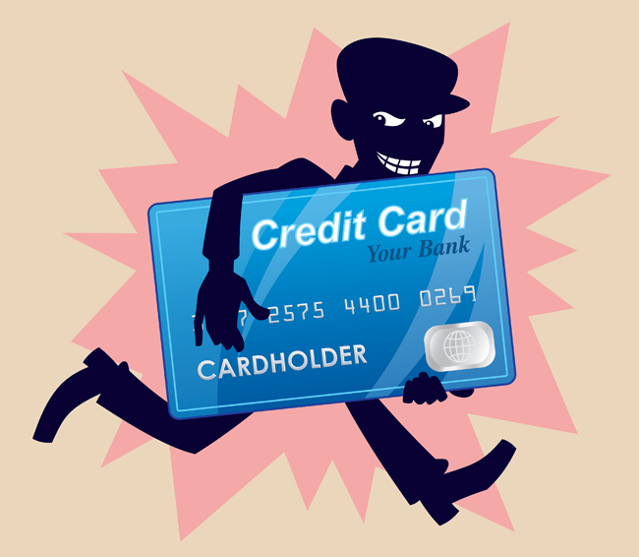
Identity Theft and Fraud
Identity theft: The use of another person’s name and Social Security number to open a new credit card.
Account take-over: The use of another person’s existing account.
Good records make it easier to uncover
and resolve fraud .

Slide 43

Act Fast When Fraud is Suspected
Prevent further fraud damage
Look at credit card and bank statements promptly when you receive them.
Dispute the charge on your credit report.
If you wait, you can get stuck with the charge.

Slide 44
Want to talk about some other credit topics?
Click here to learn about credit and debit cards
Or click here to test yourself on some wind-up questions

Slide 45


TRUE or FALSE
You pay do not pay interest on
a debit card purchase.

Slide 46
TRUE
A debit card works just like a check.

Slide 47
TRUE or FALSE
There is a credit report for everyone over age 18.

Slide 48
FALSE
There is a credit report only for people who have established a credit history.
Having no credit history can have
adverse consequences.

Slide 49
TRUE or FALSE
If you are late in making a few payments on your credit card, the interest rate you pay may increase sharply.

Slide 50
TRUE
For example, on one Platinum VISA card, the interest rate jumps from 4.9% to 30% if you pay late or miss even one payment. Late charges also accrue.

Slide 51
TRUE or FALSE
If you miss just one or two payments on your credit card, it won’t hurt
your credit rating.

Slide 52
FALSE
Even one late payment can hurt your credit score. That negative information can legally remain on your report for up to 7 years.

Slide 53
TRUE or FALSE
No one really looks at credit reports.

Slide 54
FALSE
People who lend money (for a car, home, or credit card) almost always review credit reports.
Most prospective employers look at credit reports.
You can get free copies of your credit report each year—worth reviewing!

Slide 55

Stay Connected!
Like us! www.facebook.com/careforyourfuture
Follow us! @care4yourfuture
Connect to us on LinkedIn!
Visit! www.care4yourfuture.org
www.CAREChicago.org

